Slide 1
What Counts for a DBA
Observant
Louis Davidson (drsql@hotmail.com)

Slide 2
What “is” a DBA
A definitely “different” sort of technical career
It is an amalgam of multiple career types
Including…
But not limited to..

Slide 3
50% Administrator
Protector of the data assets
Installer of software
Fixer of broken software, data, and sometimes other stuff that isn’t even vaguely in your job description..

Slide 4

35% Developer
Reviewer of code that is to be released
Fixing data messed up by code written by the 100% developers (only 10% data developer)
Possibly that was changed after your review

Slide 5
30% Manager
Negotiating with management to help avoid unrealistic expectations

Slide 6
50% Labrador Retriever
If you don’t believe me, throw a Labrador into your parking lot and your best DBA will almost certainly retrieve it*
* http://100-looneytunes.blogspot.com/2009/08/26-often-orphan.html

Slide 7

100% Busy

Slide 8
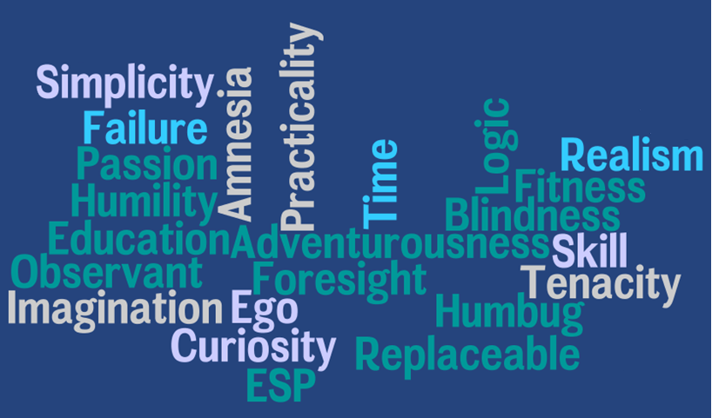
What Counts For A DBA

Slide 9

Observant
Awareness of your surroundings
Knowing where and the condition of the resources you are in charge of
Hopefully you sense the problem before it causes real harm..

Slide 10
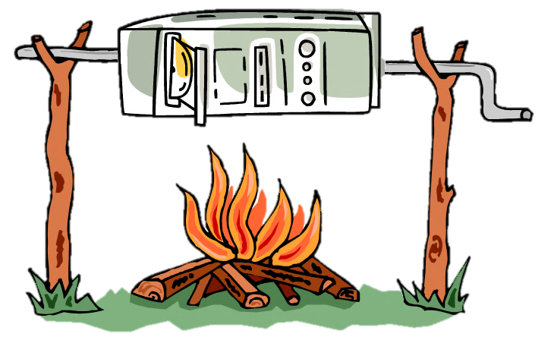
Too late, something is on fire!
“Website is slow!”
“My report is taking for-ev-er”
“I can’t work, is something broken?”
“Why can’t I get to my email?”

Slide 11


Who gets the initial blame?

Slide 12
Fair?
Sort of:
SQL Server is the backbone of almost every critical business system
Often it (well, the db code) is the problem (usually due to weak design\implementation practices)
SQL Server provides amazing tooling to determine what is currently going on inside
So the DBA often gets the call first to prove that SQL isn’t the problem…

Slide 13
Being Observant (Reactive vs Proactive)
Reactive: Hunting for the problem occurring now!
Proactive: Always expecting the worst and being prepared
Both are needed

Slide 14

Knowing what to observe is key
A strong knowledge of how to get information about your SQL Server is essential
Without knowledge, most people resort to restarting the machine
And more than I can give you in this short hour

Slide 15
Reactive Monitoring
Useful while the fire is still raging
Using your knowledge of SQL facilities
Tools:
DMVs
Extended Events, Profiler
Perfmon

Slide 16
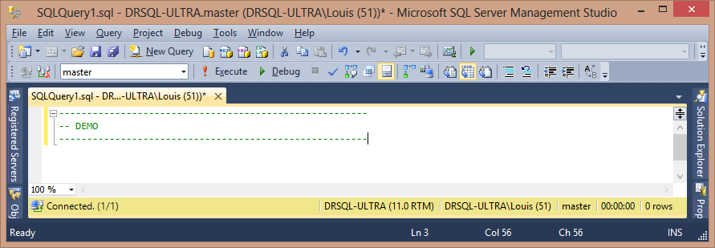
Demo - DMVs

Slide 17
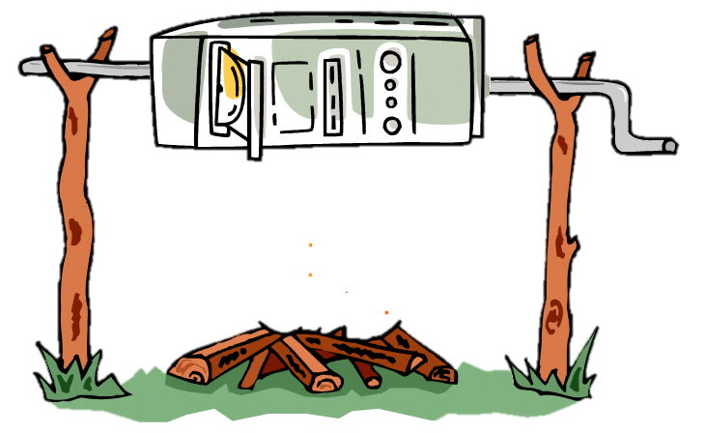
Fire is out of here!
“Website is flying!”
“My report is awesome”
“Why can’t I get to my email?”
“I can work, I hate you!”

Slide 18

40% Fire-person

Slide 19
Proactive Monitoring
Always being alert for changing patterns
Dealing with issues even before the customer notices
Two types, which go hand in hand
Home grown: highly customized for your particular situation
Packaged solution such as Red Gate SQL Monitor: covers the vast majority of needs, also customizable
Goal: Prevent the conditions for fire before the blaze starts

Slide 20
60% Fire-Marshall

Slide 21
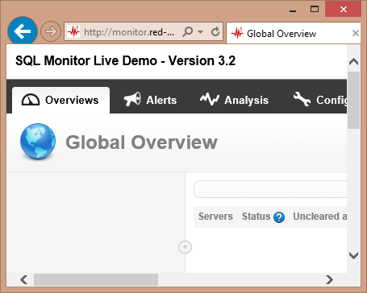
Demo – Proactive Monitoring

Slide 22
50% Detective
Searching through evidence to see what happened (and prevent a repeat occurrence)
Avoid overdoing it and causing performance issues looking for problems

Slide 23
100% DBA

